Slide 1
Japan Unit Plan
Jen Meliambro
EDU 521.02
Prof. R. Moroney
Summer 2010

Slide 3
Introduction
The following thematic unit focuses on the history, geography, and culture of Japan, including: major holidays; information on life as a Japanese student; everyday activities; and common cultural ground between Japanese and American children. This unit is created for a third grade class of 22. It is designed to be four weeks in length, consisting of five class sessions per week that last approximately 35 minutes each. The second to last class session consists of a unit exam that will last for the duration of the period, and, during the very last class session, students will observe and present their PowerPoint projects.
During the first lesson, students will utilize a teacher generated Internet “Hotlist” to gather research about Japanese geography, history and culture. For the second lesson, students will focus on the Internet site http://web-japan.org/kidsweb/, gathering information on the similarities and differences between Japanese and American students’ lives and presenting this information in the form of an Inspiration Venn Diagram. For lessons three through six, students are assigned Key Pals in a corresponding Japanese classroom and become involved in a series of activities, including: introductory conversations; discussions that compare and contrast the students’ lives in differing countries; a collaborative project via epals.com; a class Skype conversation; and the construction of a blog between the two classes, focusing on a “Life as a Third Grader” theme. In lesson seven, students break into small groups and collaboratively create PowerPoint presentations on Japanese history, geography and culture. For the final, eighth lesson, students will draw on the information they’ve gathered throughout the unit and create travel brochures, informing readers about the country of Japan and the various topics they’ve studied.

Slide 4
The Context of My Project
The participants of my project are a class of third grade students.
There are 22 students in the class.
The group has experience with keyboarding, basic Internet search skills and use of Microsoft Word.
The classroom has a SMART Board with Internet access and three computers, and the class uses the computer lab twice weekly.
I will not be collaborating with a fellow classroom teacher for the purpose of teaching this unit, but I will have a Teaching Assistant, a one-on-one aide for a special needs student and a Computer Teacher in the computer lab to assist me.
The two detailed lesson plans are the seventh and eighth lessons in my unit. They fully incorporate technology as the students rely on Internet-based research to create both group PowerPoint presentations and informative travel brochures on Japan via Microsoft Publisher.

Slide 5
Aim of the Project
I want students to gain a greater global understanding, particularly by focusing on the nation of Japan. I want them to learn about Japanese history, geography and culture and how America has adopted certain Japanese cultural influences. Students will be able to compare and contrast American and Japanese cultures and will become familiar with life as a child in Japan.
Students will demonstrate this knowledge by creating both group PowerPoint presentations and individual travel brochures including information on the history, geography, and culture of Japan. They will interact with Japanese Key Pals in a corresponding third grade class via AIM, epals.com, Skype, and through an interactive blog maintained for the two classes.

Slide 6
Justification
Why am I using technology to meet my goals?
-Technology greatly enhances the study of Japan. Arguably, Japan can be considered a forerunner in modern technological devices; students can gain a sense of Japanese culture by engaging in technology.
How does technology support my curriculum?
- Technology amplifies the media resources available for students throughout their unit of study. It also serves as a motivating factor as an engaging, stimulating medium for learning. Technology also increases means of appealing to different learning styles, accommodating a variety of divergent student styles.

Slide 7
Materials
A computer lab with multiple computers
Color printer
Microsoft PowerPoint software
SMART Board with notebook software
Internet access
Social Studies notebooks
Writing folders
Pencils

Slide 8
Materials (Continued)
IntelliKeys USB
Teacher generated “Hotlist” from Filamentality by AT&T
Index cards
Microsoft Publisher software
Microsoft Word software
Welcome to Japan book
A Primary Source Guide to Japan

Slide 9
Time Frame
I may want to create an outline, table, or chart
What is the overall length of my unit?
How long is each specific lesson? Realistically.

Slide 10
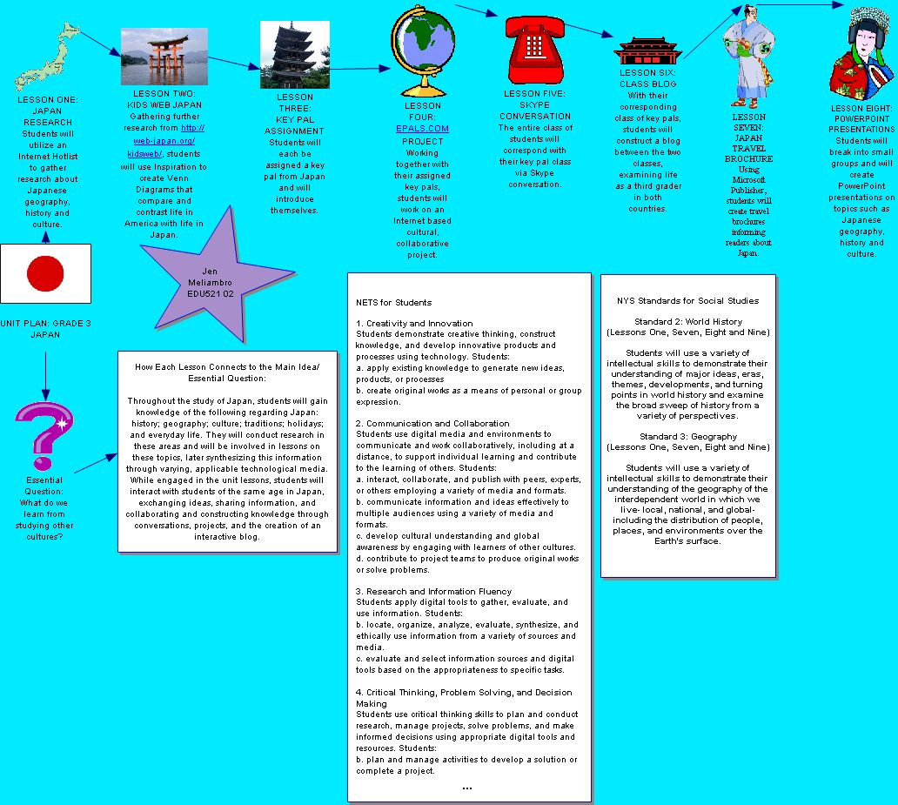
Graphic Organizer Project
Copied and pasted or exported as an image file (jpeg file format)

Slide 11
New York State Standards & NETS for Students Addressed in this Unit
NYS Standards for Social Studies
Standard 2: World History
(Lessons One, Seven and Eight)
Students will use a variety of intellectual skills to demonstrate their understanding of major ideas, eras, themes, developments, and turning points in world history and examine the broad sweep of history from a variety of perspectives.

Slide 12
New York State Standards Continued
N YS Standards for Social Studies
Standard 3: Geography
(Lessons One, Seven and Eight)
Students will use a variety of intellectual skills to demonstrate their understanding of the geography of the interdependent world in which we live- local, national, and global- including the distribution of people, places, and environments over the Earth’s surface.

Slide 13
NETS for Students Continued
Creativity and Innovation
Students demonstrate creative thinking, construct
knowledge, and develop innovative products and
processes using technology. Students:
a. apply existing knowledge to generate new ideas, products or processes
b. create original works as a means of personal or group expression

Slide 14
NETS for Students Continued
2. Communication and Collaboration
Students use digital media and environments to communicate and work collaboratively, including at a distance, to support individual learning and contribute to the learning of others. Students:

Slide 15
NETS for Students Continued
interact, collaborate, and publish with peers, experts, or others employing a variety of digital environments and media.
communicate information and ideas effectively to multiple audiences using a variety of media and formats.
develop cultural understanding and global awareness by engaging with learners of other cultures.
contribute to project teams to produce original works or solve problems

Slide 16
NETS for Students Continued
3. Research and Information Fluency
Students apply digital tools to gather, evaluate and use information. Students:
b. locate, organize, analyze, evaluate, synthesize, and ethically use information from a variety of sources and media.
c. evaluate and select information sources and digital tools based on the appropriateness to specific tasks.

Slide 17
NETS for Students Continued
4. Critical Thinking, Problem Solving, and Decision Making
Students use critical thinking skills to plan and conduct research, manage projects, solve problems, and make informed decisions using appropriate digital tools and resources. Students:
b. plan and manage activities to develop a solution or complete a project.

Slide 18
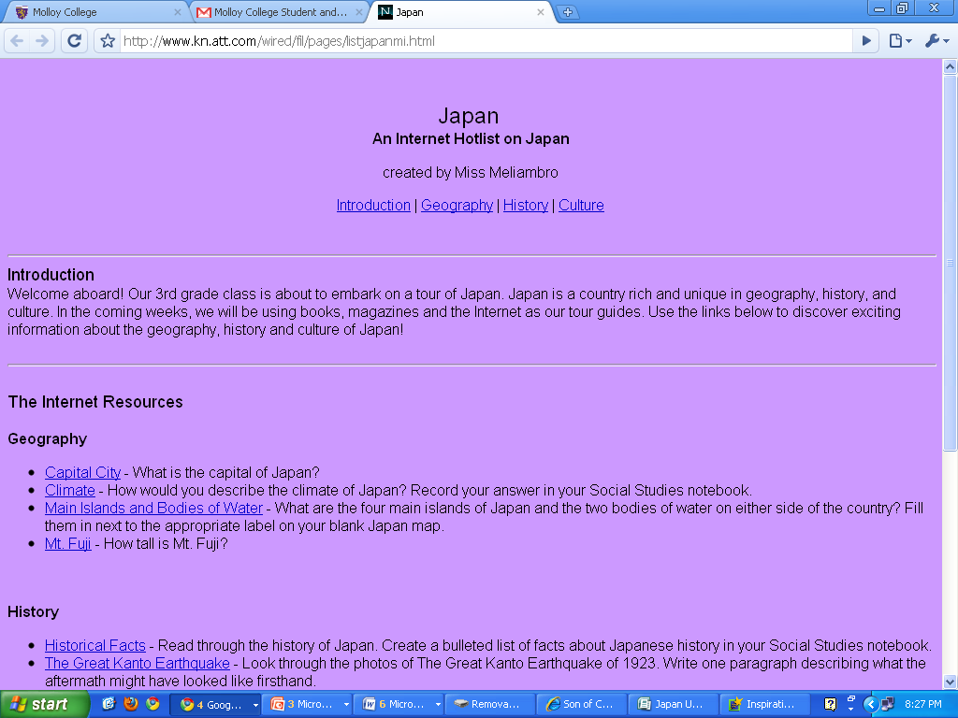
Filamentality Project
Included a screen shot that is hyperlinked to your Hotlist.

Slide 19
Lesson Plans
Lesson Seven: Japan Travel Brochure Project
INSTRUCTIONAL OBJECTIVES
Following a class discussion on Japan information that would be appropriate to include in a travel brochure, students will demonstrate their knowledge of Japan by creating travel brochures on the country that informs readers of the following: Japan’s history, geography, and culture; major Japanese holidays; school life for Japanese children; and miscellaneous Japan facts. A minimum score of 2 is required on the embedded rubric.

Slide 20
Lesson Plans Continued
Lesson Eight: PowerPoint Presentations
INSTRUCTIONAL OBJECTIVES
Following a class discussion about elements of
Japanese culture in America and a lesson that
includes a teacher generated “Hotlist,” students will
demonstrate their knowledge about the country by
breaking into groups and creating PowerPoint
presentations on Japanese history, geography and
culture. A minimum score of 2 is required on the
embedded rubric.

Slide 21
Different Forms of Technology
Lesson Seven: Microsoft Word and Microsoft Publisher
Lesson Eight: Microsoft PowerPoint
SMART Notebook Activity: Geography and Culture Word Sort (part of Japan unit review)
Adaptive or assistive technology: IntelliKeys USB in Lessons Seven & Eight

Slide 22
Weebly website for Japan Unit Plan

